Slide 1
Namma Yatri
Strategy Review
High-Level Insights | Business Recommendations
Shayak Majumder
Sharath Chanda Reddy
Satya Ranjan

Slide 2
Agenda
01
Executive Summary
Slide 03
02
Key Business Questions, Actions,
& Goal
Slide 04
03
Insights
Slide 05-09
04
Marketing Strategy Recommendations
Slide 10
05
Operational Recommendations
Slide 11
06
Expected Business Impact
Slide 12
Confidential

Slide 3
Executive Summary
Analysis of ride data for efficiency & strategy optimisation.
Focus on top zones, peak hours, and performance metrics.
Confidential

Slide 4
Key Business Questions, Actions, & Goal
When is ride demand highest?
Which zones generate most revenue?
Where are cancellations high?
Improve Efficiency
Enhance Customer Satisfaction
Maximise
Revenue
Confidential

Slide 5
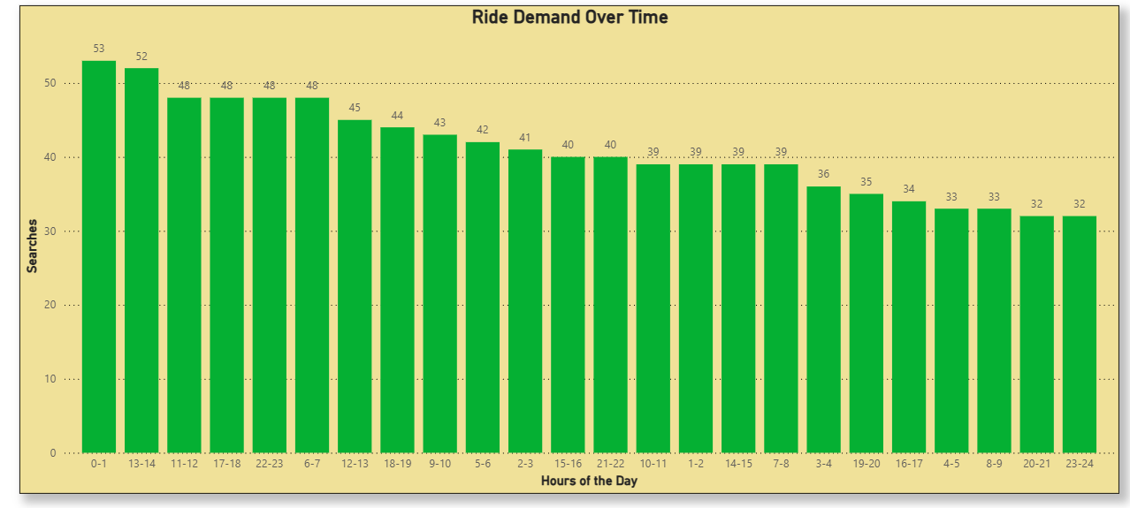
Insights
Ride Demand Over Time
Peak
Lowest
12–1 AM
1–2 PM
11 PM - 12AM
Confidential

Slide 6
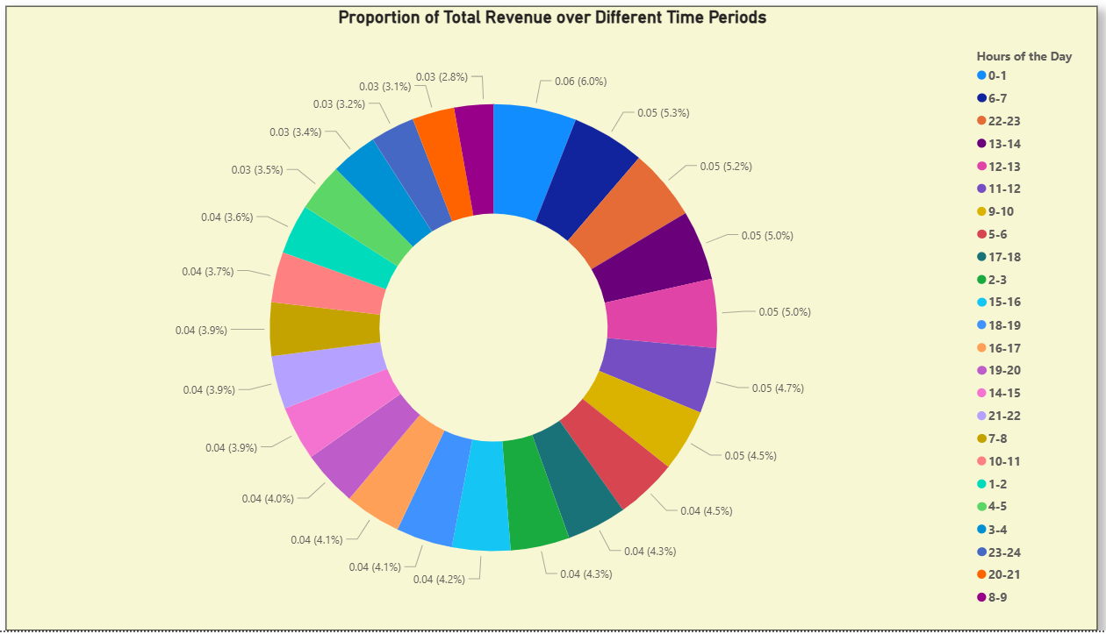
Insights
Revenue Trends by Hour
Highest Revenue
12–1 AM and 6–7 AM show highest revenue.
Confidential

Slide 7
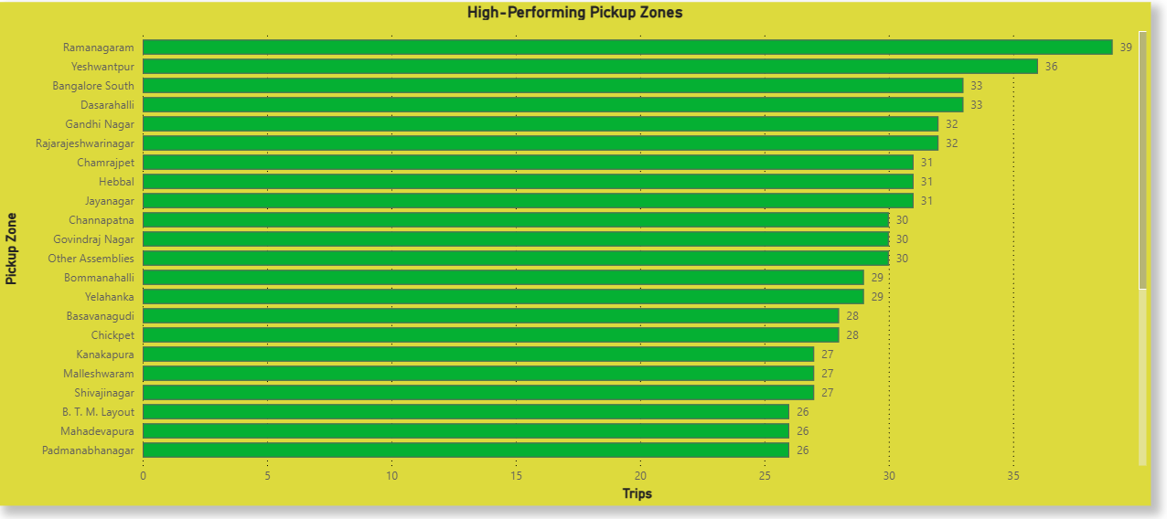
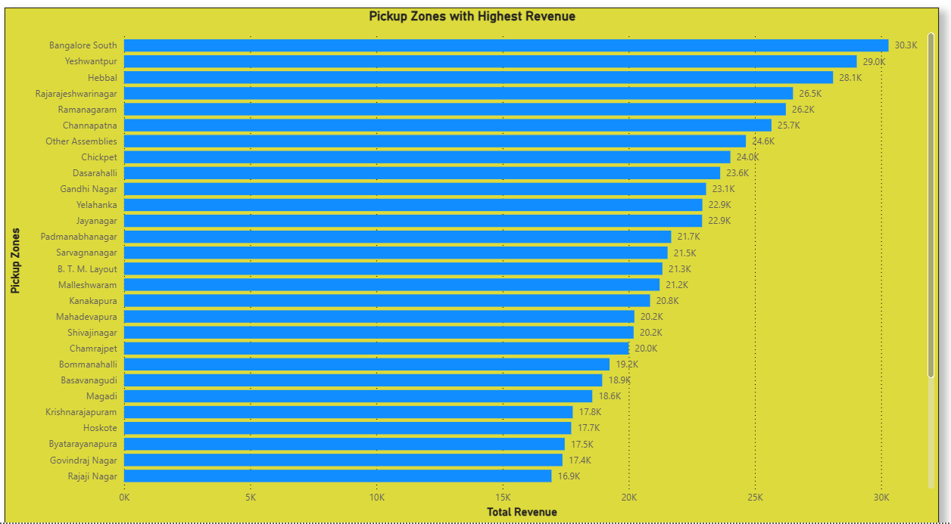
Insights
Zone-Wise Performance
Trips
Ramanagaram leads
Revenue
Bangalore South leads
Confidential

Slide 8
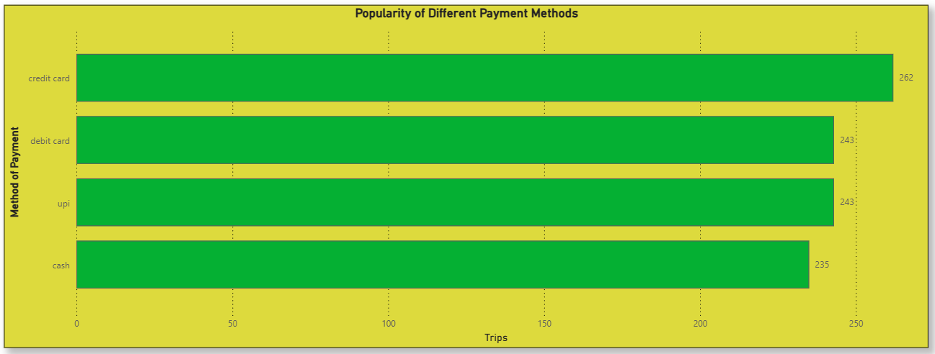
Insights
Payment Method Preferences
Most Used
Credit Cards, followed by UPI & Debit Cards.
Cash least preferred.
Confidential

Slide 9
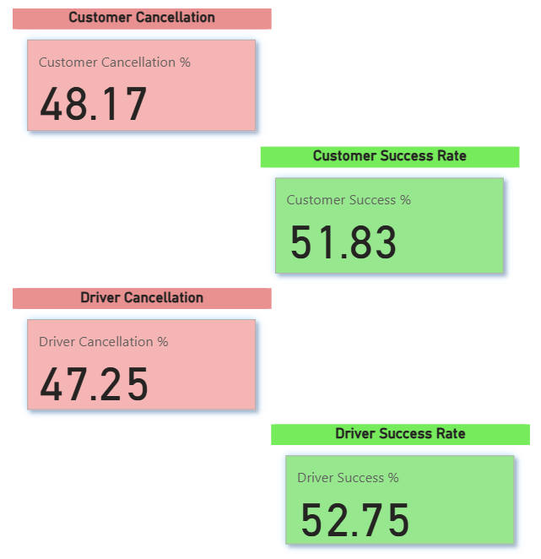
Insights
Cancellations
Driver Vs Customers
Driver & Customer success rates slightly higher than cancellations
Confidential

Slide 10
Marketing Strategy Recommendations
Promote Low-Revenue Time Slots
Hyperlocal Marketing in Underperforming Zones
Recommendation: Launch time-based discounts or loyalty rewards to increase ridership during the 8–9 AM time slots.
Recommendation: Run targeted promotions or awareness campaigns in regions such as Doddaballapur and Nelamangala.
Promote Card & UPI Payments
Advertise Safety and Reliability in Night Hours
Recommendation: Incentivise digital payments through cashback or app-exclusive discounts.
Recommendation: Position Namma Yatri as a safe night-time option through marketing with emphasis on OTP and successful completion rates.
Confidential

Slide 11
Operational Recommendations
Driver Incentives in High-Demand Zones
Recommendation: Offer bonuses for completing rides in revenue-leading zones such as Bangalore South and Yeshwantpur, especially during peak hours.
More Hands On Deck
Recommendation: Deploy more drivers during peak time zones.
Confidential

Slide 12
Expected Business Impact
Reliability
Reduced cancellations and wait times.
Profitability
Improved revenue per zone and hour.
Adoption
Higher app usage in underperforming areas.
Confidential

Slide 13
Thank you!
Confidential

